Slide 1
Disclosure of suspect TB in live cattle and dealing with singleton reactors which are post-mortem negative
Approved Veterinary Surgeon Annual TB Training
Andrew Doyle

Slide 2
Part 1
Testing for TB

Slide 3
How live cattle suspected of being infected with TB are disclosed
Immune Response
Clinical signs
Disclosure

Slide 4
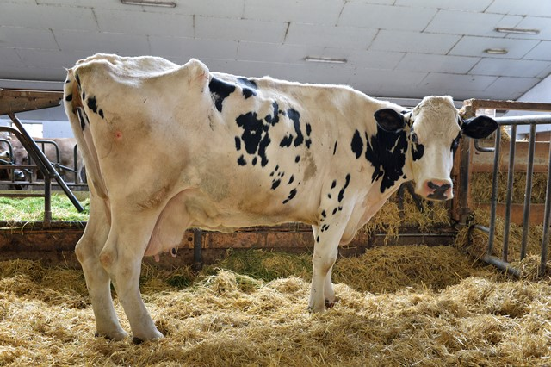
Clinical signs of TB in cattle
Signs only develop in advanced stages of infection.
Look out for:
Emaciation
Fever
Weakness
Reduced appetite according to owner
Swollen lymph nodes,
typically submandibular, retropharyngeal or prescapular
Moist cough
Chronic mastitis, check supramammary lymph nodes

Slide 5
Disclosure by tests depending on immune response
Immune Response
Cell Mediated Response
Humoral Response
SICCT
Interferon Gamma Test
Antibody Tests

Slide 6
Interferon gamma (IFNG) test
Laboratory-based
so standardisation of test procedure compared to SICCT
Supplementary test approved in the EU for use in conjunction with the skin test
Usually used in confirmed breakdown herds

Slide 7
Interferon gamma (IFNG) test
T lymphocytes in blood from cattle that have come into contact with M. bovis release the cytokine Interferon-gamma when stimulated with tuberculin antigens in vitro.
The IFNG test can identify infected animals a little earlier in the infection process than the SICCT.

Slide 8
The IFNG test can identify a population of M. bovis-infected animals that are missed by the SICCT and so the combined use of IFNG and SICCT can result in removal of a higher proportion of infected animals than use of the SICCT alone.
IFNG positive
SICCT
positive
7.7%
18.4%
3.3%
Post –mortem Positive animals
7.8%
50.7%
12.1%
In 2013 a total of 922 animals were parallel tested and were slaughtered because they were positive to either the IFNG test or the SICCT test or both.

Slide 9
Advantages of IFNG | Disadvantages of IFNG
Standardisation of procedure | Cost
Sensitivity of 90% | Specificity of 96.5%
Can identify some diseased animals missed by SICCT | Short viability of blood cells
Less influenced by immunosupression than SICCT | Samples need to be taken before SICCT gets underway

Slide 10
The Single Intradermal Comparative Cervical Tuberculin Test
Complex immune response which reaches a peak 72 hours after intradermal injection of tuberculin
Involves inflammatory cells (lymphocytes, neutrophils, macrophages, Langerhans cells), fluid (lymph and plasma) and fibrin.

Slide 11
Differences between the immunological processes taking place in IFNG and SICCT
IFNG | SICCT
One cytokine measured (Gamma Interferon) | Array of cytokines produced
Cytokine does not act on macrophages | Complex delayed hypersensitivity reaction produced
Interference of assay by other cytokines unlikely | Reaction modulated by a range of cytokines

Slide 12
Antibody Tests
No antibody tests are officially approved to test for TB in cattle in the EU.
The sensitivity of antibody tests is generally low.
As they are based on identifying the presence of specific antibodies, the specificity of an antibody test can be high.

Slide 13
Antibody Tests
Antibodies are produced in reaction to presence of M. bovis
Presence of M. bovis in the blood stream would only be expected late in the disease process but the University of Nottingham work on a Phage test raises questions.

Slide 14
Antibody Tests
Animals with circulating M. bovis are potential TB spreaders.
Some infected animals with a poor cell mediated response may produce antibodies which could be detected with an antibody test.

Slide 15
Antibody Tests
Therefore antibody tests could be useful in identifying cattle which are
infected but are not SICCT or INFG reactors or
infected and potentially more likely to be infectious.

Slide 16
Antibody Tests
Test | Principle
Multiantigen print immunoassay (MAPIA) | A selection of antigens are printed onto a membrane and antibody responses to each are measured for each animal
Fluorescence polarisation assays (FPA) | Antigen with a fluorescent molecule bound to it is added to serum. If antibody is present in the serum it binds to the antigen to make a fluorescent antigen-antibody complex
Immunochromatographic lateral flow test (e.g. ‘StatPak’) | Coloured latex beads impregnated with antigen are mixed with serum. The material flows along a membrane by capillary action across a line where antigen has been impregnated onto the membrane. Where coated latex beads have bound to antibody in the serum these then bind to the membrane making a coloured line

Slide 17
Antibody Tests
Test | Principle
Single antigen chemiluminescence e.g. SeraLyteMbv using the Total Optical Assay Device (TOAD) | Magnetic iron beads coated with antigen are mixed with animal serum and collected magnetically. Any bound antibody is then detected using a specific anti-bovine antibody and identified using a chemiluminescent reaction
Multiplex chemiluminescence immunoassay (e.g. Enferplex) | Where individual antigens are printed in small dots on a 96 multiwell plate. Individual serum samples are added to each well. Anti-bovine antibody attachment indicates specific antibody when present.
Enhanced conventional enzyme linked immunosorbent assays (ELISA) (e.g. IDEXX M. bovis assay | A cocktail of M. tuberculosis complex specific antigens are used in a conventional antibody detection system using optimised reagents

Slide 18

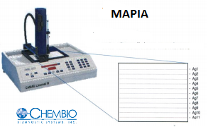

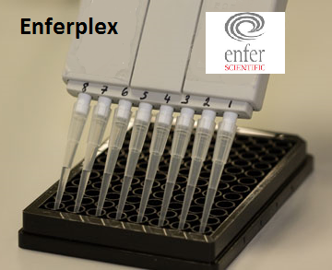
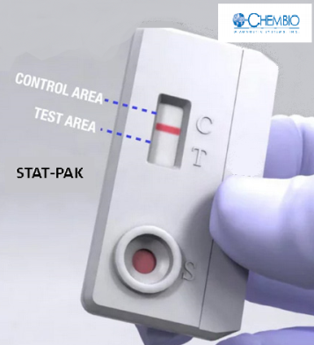
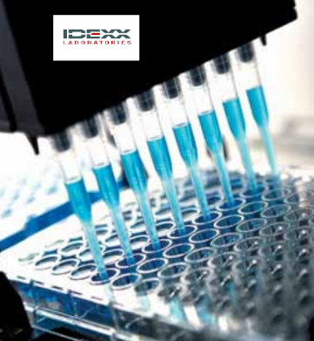
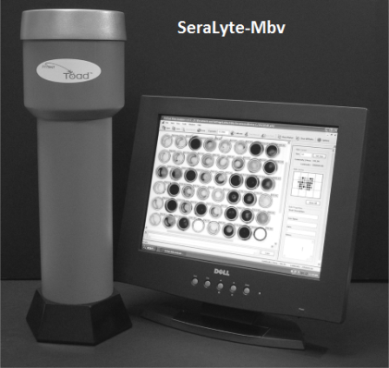
Antibody Tests

Slide 19
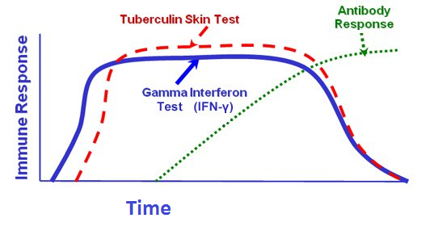
This graph illustrates the windows when SICCT, IFNG and Antibody tests will yield most useful results.

Slide 20
An interesting development...
Disclosure
Immune Response
Clinical signs
Demonstration of M. bovis
in live cattle
Phage PCR

Slide 21
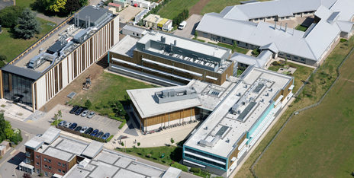
Phage PCR
The University of Nottingham is working on a bacteriophage-based method of detecting live M. tuberculosis complex bacteria in monocytes.
Benjamin M. C. Swift, Thomas W. Convery and Catherine E. D. Rees
Evidence of Mycobacterium tuberculosis complex bacteraemia in intradermal skin test positive cattle detected using phage-RPA
Virulence 19 May 2016 (online)

Slide 22
Phage PCR
Recombinase Polymerase Amplification (RPA) is used to detect the phage infected bacteria.
Experimentally, when blood samples from SICCT-positive animals were tested, viable M. tuberculosis complex bacteria were detected in 66 % of 41 samples.

Slide 23
We can disclose suspected TB and confirm TB in carcasses.....
Lesion
Histopathology
Culture
Genotype
Spoligotype
Genotype:Spoligotype
......but not all infected animals are lesioned and few animals which are not lesioned have TB confirmed by culture

Slide 24
Part 2
Dealing with Singleton Reactors which are post-mortem negative

Slide 25
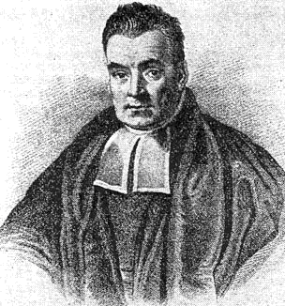
How confident can we be that a Singleton reactor which is not lesioned is a True Positive?
Surveillance
Immune Response
Cell Mediated Response
Humoral Response
Single Intradermal Comparative Cervical Tuberculin Test
Interferon Gamma Test
Antibody Tests
Clinical signs
Reverend Thomas Bayes
Lesion
Histopathology
Culture
Genotype
Spoligotype
Genotype:Spoligotype
1701–1761

Slide 26
Bayesian thinking and the SICCT
Bayesian thinking applied to the SICCT helps us to view a positive SICCT result in context.
The context is prevalence, SICCT test performance and Post-Mortem test performance.

Slide 27
Bayesian thinking and the SICCT
How do we judge a reactor when we know that
TB is prevalent
Post-mortem inspection is an inefficient way of confirming the presence of TB even in known infected animals

Slide 28
Bayesian thinking and the SICCT
Bayesian thinking fills in the gap between getting a positive SICCT test result and getting the absolute certainty of infection provided by culture and identification of M. bovis in a sample taken from the animal.

Slide 29
The unconfirmed singleton reactor
We need to be confident that the odds of a singleton reactor being infected is high so that
we are confident to disclose the animal as a reactor
we can assure the herd keeper of the need to remove the reactor.

Slide 30
The unconfirmed singleton reactor
The following slides provide the statistical support for our belief that a singleton reactor is likely to be infected.

Slide 31
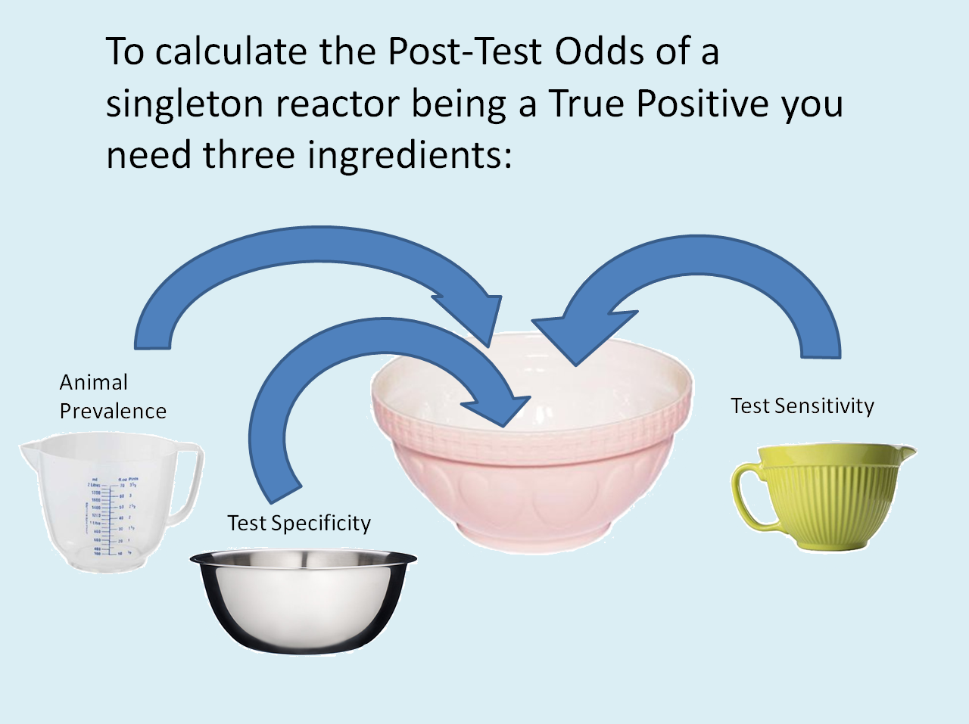
Post-Test Odds

Slide 32
To find the Post-Test Odds there are 4 steps
Find the True Animal Prevalence using the Rogan-Gladen Estimator
Convert the True Animal Prevalence to Pre-Test Odds
Find the Positive Likelihood Ratio
Calculate the Post-Test Odds using the Pre-Test Odds and the Positive Likelihood Ratio

Slide 33
Calculate the True Animal TB Prevalence using the Rogan-Gladen estimator
1
The Rogan-Gladen Estimator :
True Animal Prevalence in 2014 was 0.00561 (0.561%)
Lewis and Torgerson (2012)
1

Slide 34
True Animal Prevalence is converted to Pre-Test Odds
The Pre-Test Odds are the odds of an animal being diseased. Once we know the True Animal Prevalence we can calculate the Pre-Test Odds.

Slide 35

Positive Likelihood Ratio
The Positive Likelihood ratio is a measure of the value of performing a test and is defined as the probability of an animal which is TB infected testing positive divided by the probability of an animal which is not TB infected testing positive.

Slide 36

Post-test odds
The Post-Test Odds is the odds of the test disclosing a True Positive rather than a False Positive and is a product of the Pre-Test Odds and the Positive Likelihood Ratio.
Post-test odds = pre-test odds x positive likelihood ratio
1
1
Ebell and Barry (2008)

Slide 37
Using a True Prevalence of 0.00561, a sensitivity of 0.51 and a specificity of 0.9998,
Post-test odds = 0.0056416 x 2550
= 14.4:1
1
2
1
2
Downs et al., 2011 Goodchild et al., 2015

Slide 38
The density of herds with TB reactors varies throughout Northern Ireland
The TB Heat Map for 2015 indicates that the density of herds with TB reactors varies throughout Northern Ireland and it follows that confirmed animal prevalence will also vary throughout Northern Ireland.

Slide 39
So what would the Post-Test Odds be if the True Prevalence was 0.008522?
Post-test odds = 0.008522 x 2550 = 21.73:1
which means that for every 1 non-infected singleton reactor disclosed there will be about 22 infected singleton reactors.
These are the Post-Test Odds that the reactor was diseased at the prevalence level in Newtownards DVO in 2014.

Slide 40
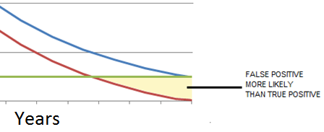
... What if the prevalence level was really low?
Say the True Prevalence was as low as 0.00001 i.e. one in 100,000.
Pre-test odds approach zero and so for every 1 non-infected reactor there will be almost no chance of an infected reactor.

Slide 41
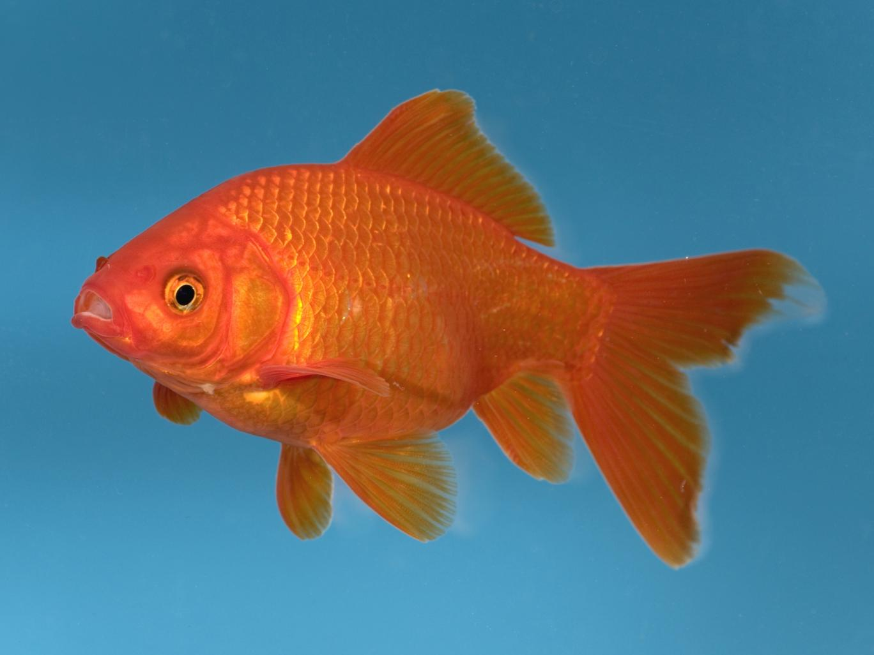
How much of this can I remember?

Slide 42
Remember this:
Operating the test in the range of True Animal Prevalence levels we have, and at standard interpretation level, the Post-Test odds of a reactor being a True Positive is high.
As we approach eradication, the Post-Test odds of a reactor being a True Positive will decrease, reaching zero at eradication.

Slide 43
What do we say to the farmer in the case of a negative post-mortem result for a singleton reactor?
The odds of the animal having TB is very high, regardless of a negative PM result.
The Post-Mortem exam is not designed to validate the SICCT. It is difficult to find lesions even when they are present.

Slide 44
What if there are two reactors at the test?

Slide 45
Post-test Probability
We can convert odds to probabilities.
Post-Test Probability = Post-Test Odds/(1 + Post-Test Odds)
We can now look at the probability of at least one of two reactors at a herd test being a True Positive.
Akobeng 2006

Slide 46
What if there are two reactors at the test?
PTP = Post-Test Probability that a reactor animal is a True Positive
1-PTP = Post-Test Probability that a reactor is a False Positive
(1-PTP)² = Post-Test Probability that both of two reactors are False Positives
1-(1-PTP)² = Post-Test Probability of at least one of the two reactors being a True Positive

Slide 47
What if there are two reactors at the test?
Using the PTP estimate derived using the Northern Ireland animal prevalence level for 2014, the PTP for at least one of two reactors being a True Positive is
1-(1- 0.935006)² = 1- 0.00422 = 99.6%
This very high Post-Test Probability that one of two reactors is a True Positive will allow you to impose disease control measures on herds with two reactors with confidence.

Slide 48
Acknowledgements
Thanks to staff of the Veterinary Epidemiology Unit who provided me with advice in the preparation of this presentation.

Slide 49
Sources
Benjamin M. C. Swift, Thomas W. Convery and Catherine E. D. Rees
Evidence of Mycobacterium tuberculosis complex bacteraemia in intradermal skin test positive cattle detected using phage-RPA
In Virulence, accessed 04 September 2016
Sam A. J. Strain James McNair Stanley W. J. McDowell
Bovine tuberculosis: A review of diagnostic tests for M. bovis infection in cattle AFBI
May 2011
Fraser I Lewis and Paul R Torgerson (2012)
A tutorial in estimating the prevalence of disease in humans and animals in the absence of a gold standard diagnostic
Emerging Themes in Epidemiology, Published online December 2012

Slide 50
Sources
Meta-analysis of diagnostic test performance and modelling of testing strategies for control of bovine tuberculosis
Downs, S.H., Parry, J., Nunez-Garcia, J., Abernethy, D.A., Broughan, J.M., Cameron, A.R.,
Cook, A.J., de la Rua Domensch, R., Goodchild, A.V., Greiner, M., Gunn, J., More, S.J., Rhodes, S., Rolfe, S., Sharp, M., Upton, H.M., Vordermeier, H.M., Watson, E., Welsh, M., Whelan, A.O.
Proceedings of the Society for Veterinary Epidemiology and Preventive Medicine 2011
Leipzig, Germany, 23
Pages 139-153
Tuberculosis: Statistics for December 2015
Produced by Veterinary Epidemiology Unit, Daera

Slide 51
Sources
Specificity of the comparative skin test for bovine tuberculosis in Great Britain
A. V. Goodchild, S. H. Downs, P. Upton, J. L. N. Wood and R. de la Rua-Domenech
Veterinary Record September 2015 Volume 12 p 177
Understanding diagnostic tests 2: likelihood ratios, pre- and post-test
probabilities and their use in clinical practice. REVIEW ARTICLE
Anthony K. Akobeng
Acta Pædiatrica 2006 96, pp. 487–491
Mark Ebell and Henry Barry (2008)
Evidence Based Medicine Modules
Likelihood Ratios Part 2: Bedside Calculation
Office of Medical Education Research and Development
College of Human Medicine
Michigan State University

